Slide 1

Notes:
Welcome back. Ask: who remembers the closing sentence from Workshop 1?

Slide 2

Using AI Tools to Enhance
Product Owner Decisions
Featuring: ZERO TO SPRINT-READY, Let’s build a complete backlog from one line, live
Diego Avella · AI Product Manager · Scrum Master
Workshop 2 of 2
Notes:
Welcome back. Ask: who remembers the closing sentence from Workshop 1?

Slide 3
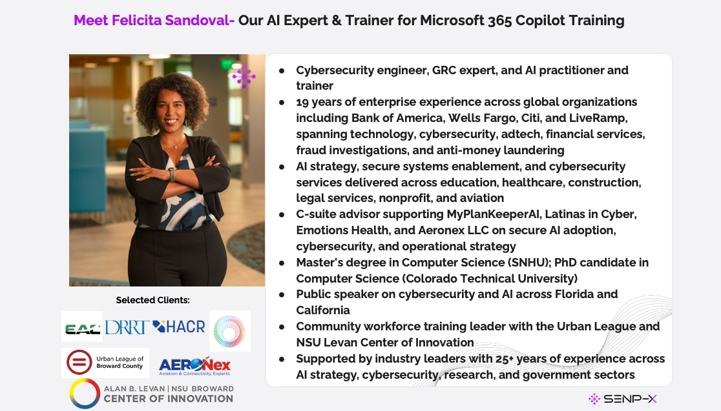

SENP-X
Notes:
Make them actually count for 20 seconds. 30-50 decisions/day is typical.

Slide 4
Yesterday:
How many decisions did you make?
How many got more than 5 minutes of thought?
The preparation eats the week. The judgment gets the leftovers.
Today we flip that ratio.
SENP-X
Notes:
Make them actually count for 20 seconds. 30-50 decisions/day is typical.

Slide 5
AI is a decision accelerator,
not a decision maker.
Everything today compresses preparation. Nothing decides. You decide.
Notes:
Repeat this at least 3 times today.

Slide 6
Today we build
1
How POs decide
5 decision types · the bias catalog · the delegation ladder
2
Prompt anatomy
R-C-T-F-C — the skill you'll use seven times
3
THE BUILD: Zero to Sprint-Ready
One idea → vision → stories → priorities → sprint plan, in 7 AI steps
4
From chat to toolchain
Jira · Azure DevOps · Trello · Miro · Figma
5
The brakes + the time math
Responsible use, and the ROI case for your boss
SENP-X
Notes:
Announce the build NOW — laptop-less people pair up early.

Slide 7
Five kinds of PO decisions
Strategic
Roadmap · vision · what we say no to
Build Step 1
Operational
Story quality · sprint readiness · DoD
Build Steps 2–4
Tactical
Prioritization · scope · MoSCoW
Build Step 5
Risk
What could go wrong · what we're not seeing
Build Step 6
Communication
Who hears what — and how
Build Step 7
SENP-X
Notes:
The build touches all five — the build IS the framework.

Slide 8
The bias catalog: name them to beat them
HiPPO
“The CEO asked, so it's a Must”
Sunk cost
“We've built half of it, so we finish it”
Recency
The last customer call rewrites the roadmap
Loudest stakeholder
Volume mistaken for importance
Technical fascination
Exciting to build ≠ valuable to ship
SENP-X
Notes:
In Build Step 5, AI catches them in the act. A bias you can name is a bias you can answer.

Slide 9
The Decision AI Delegation Ladder
4
NEVER DELEGATED
Final calls · commitments · relationships · ethics · accountability
3
AI challenges → YOU decide
Priorities, trade-offs, risk. Where decisions get ENHANCED. Today lives here.
2
AI drafts → you edit & sign
Routine output: release notes, status updates
1
AI drafts → you rewrite
First versions: story drafts, agendas — off the blank page
SENP-X
Notes:
Most AI misuse is a level error. Walk top-down: Level 4 first.

Slide 10
Prompt anatomy: R-C-T-F-C
R
Role
“You are an experienced agile coach…”
C
Context
“…for a pet-care app, 2 months from launch”
T
Task
“Pressure-test this story against INVEST”
F
Format
“PASS/FAIL per letter, then a rewrite”
C
Constraints
“Be critical. Do not soften. Max 5.”
Output quality is a function of input quality. Garbage request → garbage decision material.
SENP-X

Slide 11
⚡ LIVE DEMO
Weak prompt vs. strong prompt
Same AI. Same story. Sixty seconds apart.
The difference is everything and the difference is YOU.
The magic constraint for decision work: “Challenge me. Do not be polite.”
Notes:
Weak: 'Help me improve this user story.' Strong: full R-C-T-F-C with INVEST. Both in the Build Prompts file.

Slide 12
ZERO TO SPRINT-READY
One idea. Seven steps. One hour. You build, I guide.
→ My product: PetCare+ vet visits, vaccinations, medications. Yours: your idea.
→ Rule 1 — FICTIONAL or sanitized ideas only. No real company data in free AI tools.
→ Rule 2 — ONE conversation thread for all 7 steps. The AI's memory of step 1 powers step 7.
→ Rhythm: I demo (2 min) → you run it (3 min) → one share → next step. Worksheet = your handout.
Notes:
No laptop? Phone works. No AI access? Pair up: navigator + driver.

Slide 13
1
BUILD STEP
Strategic decision
Vision — and its weakest point
Moore's template from a one-line idea + one memorable sentence
+ “challenge your own vision: what's the weakest assumption?”
YOUR JUDGMENT: Do I accept the weak point it named — or is there a weaker one?
Notes:
Prompt 1. The self-challenge is the Level-3 move — keep that habit through every step.

Slide 14
2
BUILD STEP
Operational decision
Personas & the epic map
2 primary personas + 5-7 epics ordered as a user journey
from first discovery to daily use.
YOUR JUDGMENT: What's MISSING from the journey? Add it by hand.
Notes:
This is the story map's top row from Workshop 1, generated in 30 seconds. Gaps hide in flat lists; they're visible in journeys.

Slide 15
3
BUILD STEP
Operational decision
Stories + INVEST pressure-test
Top epic → 4-6 stories, each tested against all six INVEST letters,
failures rewritten. “Be strict.”
YOUR JUDGMENT: Was the AI strict enough? If everything passed: “Be stricter.”
Notes:
Read the FAILURES, not the passes — that's where the refinement eye gets trained.

Slide 16
4
BUILD STEP
Operational decision
Gherkin acceptance criteria
4 Given/When/Then scenarios: happy path, edge case, failure case —
and the one the team would probably forget.
YOUR JUDGMENT: The forgotten scenario = a production bug you just prevented.
Notes:
Status check after this step: vision, epics, tested stories, dev-ready criteria — ~30 min from one line. Then break.

Slide 17
Pause

Slide 18
5
BUILD STEP
Tactical decision
MoSCoW — then AI attacks it
YOU classify first . Then: “challenge my calls, name the bias,
propose corrections, and where we disagree, what evidence settles it?”
YOUR JUDGMENT: The AI's corrected MoSCoW is NOT automatically right. Disagree → define the evidence.
↩ Workshop 1 callback: The Must-have inflation I pushed back on — now AI catches it.
Notes:
Hands up: who got caught in a bias? Land: Level 3 — AI challenges, you decide. Maybe the 'questionable' Must is right for political reasons AI can't see.

Slide 19
6
BUILD STEP
Operational + Risk decision
Sprint goal + pre-mortem
Sprint 1 from the Musts at velocity ~30 + outcome-focused goal +
“it's 6 months later and the product FAILED — the 5 most likely reasons, ranked.”
YOUR JUDGMENT: Is the #1 failure reason on your risk register? It wasn't, 60 seconds ago.
Notes:
Pre-mortems used to take a meeting; now one paragraph in a prompt. Early-warning signs = the metrics shortlist, generated as a side effect.

Slide 20
7
BUILD STEP
Communication decision
One announcement, three audiences
Executive (3 sentences, business impact) · Dev team (Slack, energetic but honest)
· Early customers (plain language, no overpromising).
YOUR JUDGMENT: Every word gets YOUR review. Your name is on it, not the AI's.
↩ Workshop 1 callback: Your power-interest matrix decides who receives which version.
Notes:
After this: the 'what you built' moment — let slide 19 breathe for 20 seconds.

Slide 21
60 minutes ago: one sentence.
Now: a sprint-ready backlog.
✓ A vision, with a named weak point
✓ An epic map ordered as a user journey
✓ INVEST-tested user stories
✓ Gherkin criteria, incl. the scenario everyone forgets
✓ A bias-checked MoSCoW prioritization
✓ A sprint goal + ranked pre-mortem with early-warning signs
✓ Three audience-shaped announcements
Not a demo you watched. An artifact you built. The skill is yours.

Slide 22
Beautiful backlog. Wrong container.
It lives in a chat window. Let's move it home.
THE CSV EXPORT TRICK — one more prompt:
“Format the stories above as a CSV with columns: Summary, Description,
Acceptance Criteria, Priority, Story Points ready for Jira import.”
Jira and Azure DevOps both import CSV. Chat artifact → real backlog in five minutes.
SENP-X

Slide 23
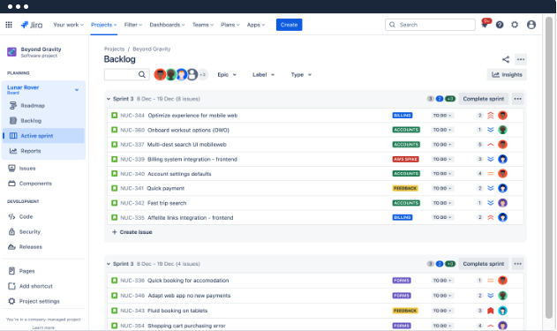
Where it lands: Jira · ADO · Trello
📷 Screenshot: Jira backlog + Atlassian Intelligence
Jira: the heavyweight
Rank = priority. Required fields enforce acceptance criteria. AI drafts, summarizes, writes JQL in plain English. Rovo agents next.
Azure DevOps
Work items + iterations. Per-person capacity (red = over-allocated). Story-to-code traceability — gold in regulated industries.
Trello — proudly lightweight
Intake board in FRONT of Jira: Ideas / Evaluating / Promoted / Rejected. Butler auto-archives 60-day cards: the graveyard rule, automated.
SENP-X
Notes:
Show of hands first: who runs Jira? ADO? Trello? Spend depth where the hands are.

Slide 24
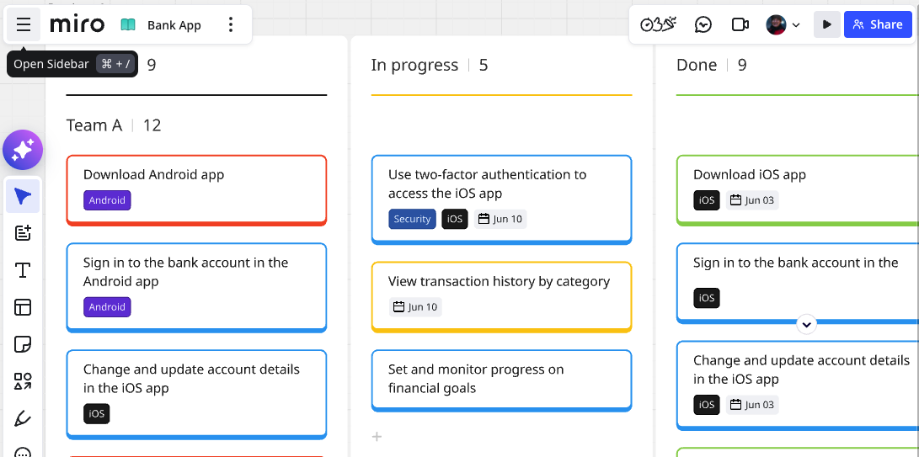
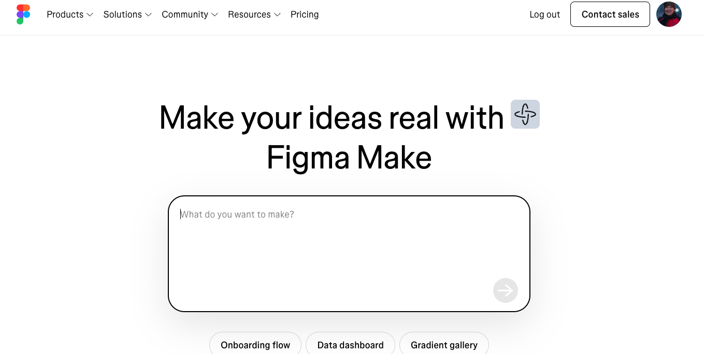
Two more homes: Miro & Figma
Miro
Paste your epic journey into a story-map template, refine WITH the team. Miro AI clusters stickies & summarizes — 40-min exercise → 10.
Figma: collaborate, don't design
Comment (threaded, pixel-anchored). Click prototypes BEFORE the sprint: a mismatch there costs a comment, not a sprint.
Figma Make AI
First-draft mockups from text. “Sketch before epic” is now same-day. A story with a sketch gets estimated better than a story with adjectives.
SENP-X

Slide 25
Convenience inside the tool.
Thinking outside it.
Embedded AI (Atlassian Intelligence · ADO Copilot · Miro AI · Figma AI) → summaries, drafts, search.
Your general AI partner (what you used for the last hour) → challenge, synthesis, pre-mortems.
SENP-X

Slide 26
⚡ BONUS DEMO
Feedback synthesis at scale
18 raw feedback items → themes with counts, sentiment, outliers, testable
hypotheses — and the question POs never ask: what's MISSING?
Today: 18 items. Same prompt: 800. The technique doesn't change, only the scale.
Notes:
Nobody mentioned security or fees — fine, or did the users who cared already leave? AI surfaces the question; only you can chase it. Prompt 8 in the handout. CUT THIS BLOCK if the build ran long.

Slide 27
The brakes
THREE RISKS
BEFORE IT SHIPS
Hallucination
1. Did I verify the facts?
Confidently wrong. Verify facts, numbers, dates.
2. Could I explain how I used AI?
Data leakage
3. Anything I wasn't allowed to share?
Today was fictional on purpose. Know your AI policy; sanitize.
4. Is the final judgment mine?
Bias amplification
AI agrees by default. Order it to challenge.
4 yeses → ship. Any no → stop.
Level 4, always: final calls · commitments · relationships · ethics · accountability.
SENP-X

Slide 28
The time math: your case for the license
TASK
MANUAL
AI-ASSISTED
Story refinement
2 hrs / week
30 min
Feedback synthesis
3 hrs (or never)
20 min
Stakeholder updates
90 min / week
15 min
Pre-mortems & risk
0 (never done)
15 min
≈ 6–8 hours / week recovered — a full working day returned to judgment.
SENP-X

Slide 29
Before we finish
Three commitments.
1
REPEAT THE BUILD
Run the 7 steps on a real (sanitized) initiative within 7 days. Second time = yours.
2
CHECK BEFORE YOU PASTE
Find your company's AI policy this week. None? Drafting it is your contribution.
3
TEACH ONE STEP
The step that surprised you most → walk a teammate through it within 7 days.
You were hired to decide. Now go decide, do it faster.

Slide 30
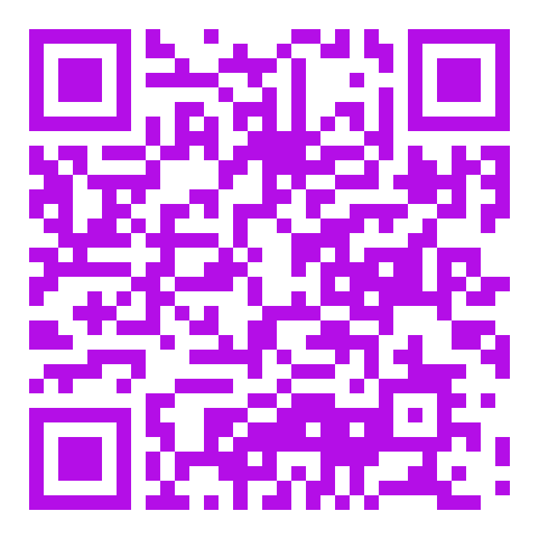
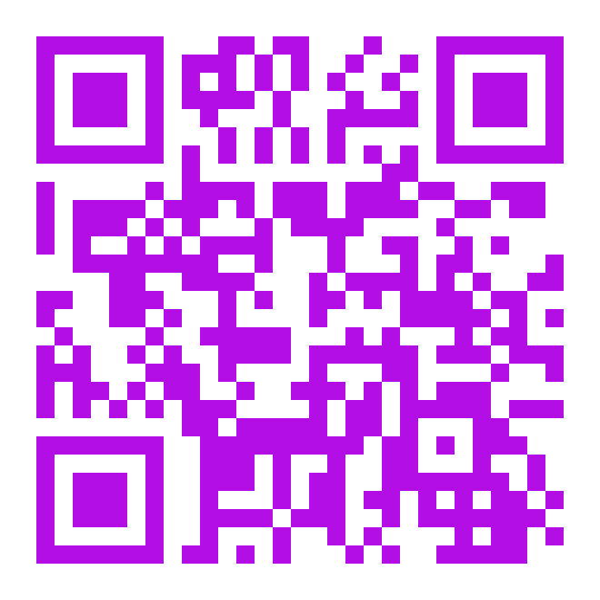
Thank You and take the toolkit home
Every prompt from today + connect with me
Prompt library & resources
Connect on LinkedIn
github.com/mr-dap-lab/productownerresources
linkedin.com/in/diego-avella
Notes:
Leave up during Q&A.

Slide 31
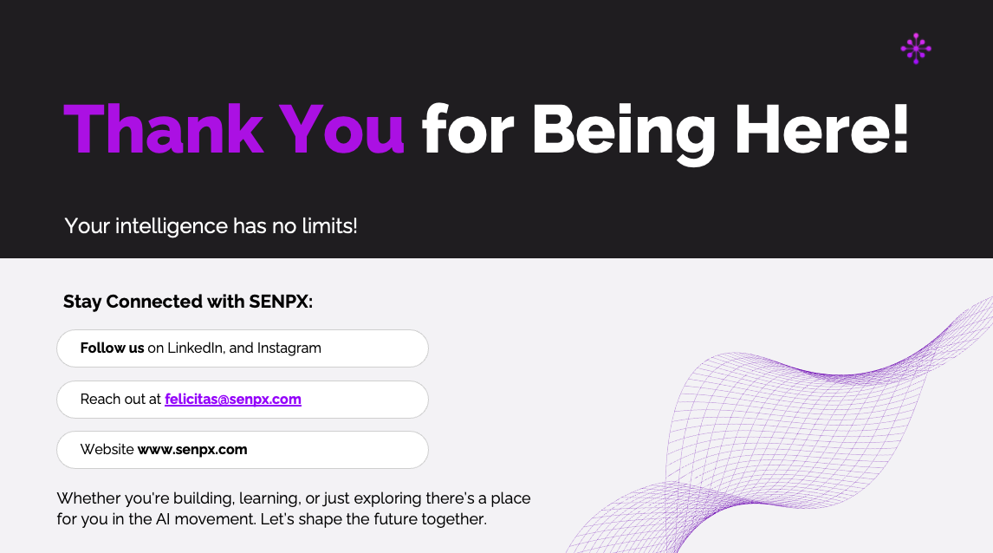
Notes:
Leave up during Q&A.

